Slide 1
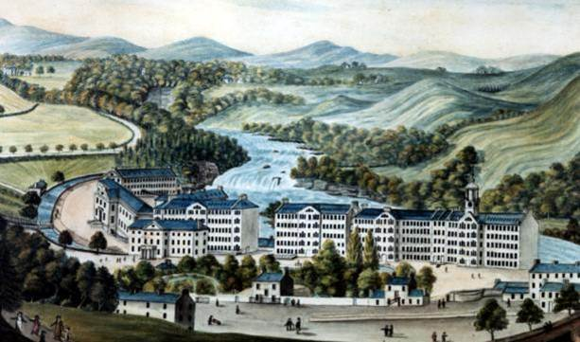
Ch. 23 Theories of Change
Irena Yang
Period 5
1/10/12

Slide 2
The Origins
The aftermath of the French Revolution was marked by the development of governments that were different and more varied than those which existed in the previous period
The Industrial Revolution was creating a new economic situation filled with uncertainty and complexity. Industrialization and industrial capitalism created new social, political, and intellectual problems Europeans faced at all levels.
New Theories of Change– Romanticism, Conservatism, Liberalism→ Utilitarianism
The early 19th century also faced a profound revolt, both philosophical and political, against traditional systems of thought

Slide 3
Romanticism (philosophy)
Origins
Characteristics:
  Exalted imagination, direct experiences and feelings
  Explored the inner life of the mind– “interested in the forces that move us or reveal us to ourselves” –Eugene Weber
  Rejected the impersonal, mechanical view of the universe
      The Enlightenment blocked emotions and creativity, while the philosophes turned man into a unfeeling machine
  Admired the heroic deeds, noble sentiments, and social harmony of the Middle Ages
  Encouraged the study of history and culture
      They valued the variety of nations, traditions and institutions throughout history (Baldwin)
  Like Jean Jacques Rousseau (1712-1778), the Romantics yearned to reclaim human freedom
    "Man is born free, and everywhere he is in chains”
    Romantics saw diversity and uniqueness, which set one man apart from another (unlike philosophes) (“Lecture 16”)
"To the romantics, nature was alive and suffused with God's presence. Nature stimulated the creative energies of the imagination; it taught human beings a higher form of knowledge/...nature did not consist of mechanical parts but of trees, lakes, mountains, clouds, and stars” (Perry, 503-4)
"...romantic poets, philosophers, and artists now denounced the rationalism of the philosophes because it crushed the emotions and impeded creativity....The reign of reason had diminished the individual" (Perry , 509)

Slide 4

Influence of Romanticism
Major movement in the arts (“Romantic Art &Literature” PPT)
Enriched European cultural life with its emphasis on personal freedom and diversity in the arts
Helped create a modern historical outlook by recognizing the unique qualities of historical periods, peoples, and cultures (Baldwin)
Inspired revolt and “its spirit infused the politics of the century and inspired its major conflicts both national and social” –Eugene Weber
Appealed to conservatives with its idealization of the traditional social and political order of the Middle Ages (“Ideological Conflict”)
Appealed to radicals with the themes of breaking old institutions and ideas, similar to how romantics broke traditional art forms (Chambers)

Slide 5

Conservatism
"It is a partnership in all science; a partnership in all art; a partnership in every virtue, and in all perfection. . . . Each contract of each particular state is but a clause in the great primeval contract of eternal society, linking the lower with the higher natures connecting the visible and invisible world, according to a fixed compact sanctioned by the inviolable oath which holds as physical and all moral natures, each in their appointed place.“
–Burke, Reflections On the French Revolution (statement shows little distinction between society and state)
“A state without the means of some change is without the means of its conservation”
–Burke, Reflections On the French Revolution (admits change is necessary to preserve institutions; also clarifies Conservatism is not the same as Counter-Revolution)
Edmund Burke credited as “Father of Conservatism”
Foundations of Conservatism based on his philosophy
Theology:
Human institutions are the product of gradual process of experience
Endured because proven effective over course of history
Imprudent to change these institutions (Riley)
Human institutions have evolved over time and are not the product of
rationally constructed plans
  Society is too complex for simple, abstract constitutions
Unrealistic to expect abstract institutions to work unless through long, gradual period of experimentation (West)
People need a sense of belonging to something larger than themselves; must endure beyond their own lives
Society cannot be built on a ‘social contract’ but by people bound together by a sense of unity (shared beliefs and experiences) and history (Riley)
Click on the picture for in-depth analysis of Burke’s ‘Reflections On the French Revolution’

Slide 6
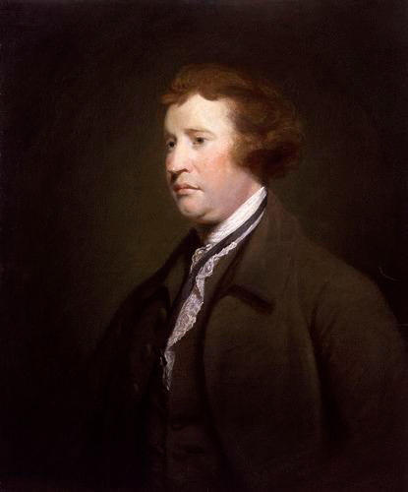
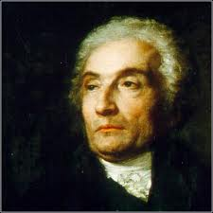
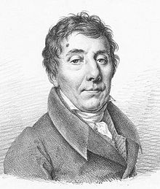
Conservatives
Edmund Burke (1729-1797) additional thoughts:
  Individualism can only lead to anarchy
  Emphasized natural hierarchy of society vs. equality (people with education, wealth should rule)
  Criticized French Revolution and made many accurate predictions that the Revolution would lead to terror and military dictatorship
Joseph de Maistre (1753-1821)
  Dismissed rationalist claims that constitutions could be made from abstract rules
  Although revolutionary constitutions are made for “man,” he argued there is no man—only Italians, Frenchmen, Russians—all unalike (Weber)
  Different from Burke: radical traditionalist, inhumane, little compromise
  Works: Human Justice (Weber pg. 319), Essay on Generative Principles of Political Constitutions (Excerpt in Chambers pg. 677, Excerpts online)
Click on a picture for bio, additional info, and more!
Louis de Bonald (1754-1840)
  Unlike Burke and de Maistre, mostly analyzes losses from the Revolution, not the Revolution itself (Devlin)
  Rejected the Enlightenment ‘individualism’
  All relations can be stated under the “three general ideas: cause, means and effect’”

Slide 7
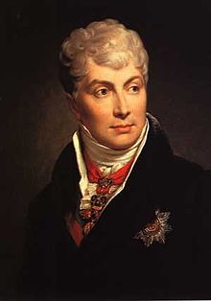
Influence of Conservatism
  Main message: What binds humans together is far greater than any ‘social’ contract which is subject to abrogation at will; No logical rationale’ can validate overturning what time and experience has produced (Riley)
Concert of Vienna (1814)
  Conservatism embodied most by Klemens von Metternich of Austria
  Believed in order, society and the state; faith and tradition
  Put Conservatism in action (begun by Burke)
This traditional Conservatism produced evolutionary variants like Neo-conservatism, Paleo-conservatism, Theo-conservatism, and Libertarianism
Click on Metternich for essay on his impact on Conservatism

Slide 8
Liberalism
Origins:
Term first used in 1812 by the Spanish political party, the Liberales
Roots from very different English & French political thought:
  England: John Locke and Adam Smith
  France: Jean Jacques Rousseau and Francois Guizot
Ideology:
Support of change in society
Political, economic, social freedom for the individual
Limited powers of government
Individual is self-sufficient being
Liberals aimed:
  To establish and protect rights
  Extend the right to vote to middle class (those with property)
  To encourage free trade

Slide 9
Political Liberalism
Basic rights (freedom of speech, press, religion, protection of property rights, etc.)
Limited suffrage
  Liberals “wanted political power to be concentrated in the hands of a safe and reliable—that is a propertied and educated—middle class (Perry 491)
Written Constitution
  Favored carefully defined constitutions to best guarantee rights (ex. Declaration of Independence, Declaration of the Rights of Man)
Contract Theory
  Right to revolution if government violates compact (Riley)
Did not support Democracy– democrats willing to endorse violence to accomplish goals (Baldwin)

Slide 10
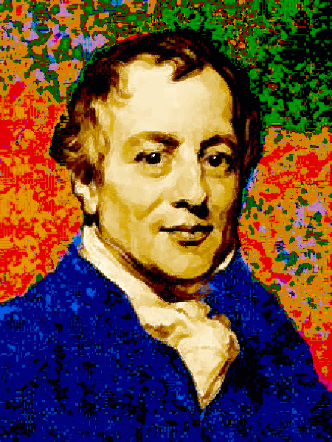
Economic Liberalism: Political Economists
(1723—1790) The Wealth of Nations (1776)
Laissez-faire: opposed gov’t involvement in social and economic activities
David Ricardo
Wealth comes from land, capital, and labor (Chambers)
Merged Locke’s ideas of civil society with economic theory
Advocated free trade; Opposed Mercantilism
“Invisible Hand”—self regulating behavior of market
Iron Law of Wages: market forces will result in subsistence wage
Labor Theory of Value: products value results from labor required to make it (Chambers)
Adam Smith
(1772—1823) Principles of Political Economy…(1817)
(1766—1834) Essay on the Principle of Population (1798)
David Ricardo (click for bio)
Thomas Malthus
  “Malthus argued that population, when unchecked, increases in a geometric ratio while the food supply increases only in an arithmetic ratio. The result will be severe overpopulation and ultimately starvation for the human race if this growth is not held in check” (Spielvogel 619)
  Did not account for the technological innovation of modern society (Industrial Revolution )

Slide 11
Liberalism vs. Conservatism
Liberalism:
Left Wing
Reform/Change society acc. to ideals of Enlightenment and French Rev.
Middle class
Emphasis on individual freedom
Individual growth
Separation of state and church
Limited monarchy
Conservatism:
Right Wing
Strengthen traditional society
Upper class
Emphasis on community
Preserve Social hierarchy
Established church
Supported status quo
Legitimate institutions
Similarities
Rejection of radicalism and violence, recognized need for limits on the powers of government, advocacy of balance in society regarding individual rights and societal powers –not so similar if analyzed further (Riley)

Slide 12
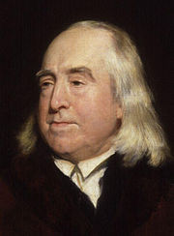
Utilitarianism
“Create all the happiness you are able to create; remove all the misery you are able to remove.”
—Jeremy Bentham
Offspring of Jeremy Bentham (1748-1832):
  “The good of a society is the sum of happiness of the individuals in that society
  The purpose of morality is promotion of the good of society
  A moral principle is ideal if and only if universal conformity to it would maximize the good of society
  Universal agreement to the principle of UTILITY (greatest good for the greatest number) would maximize the good of society” (“Utilitarian philosophy”)
  State central role, unlike most Liberals who favored limited government involvement (Chambers)
Jeremy Bentham

Slide 13
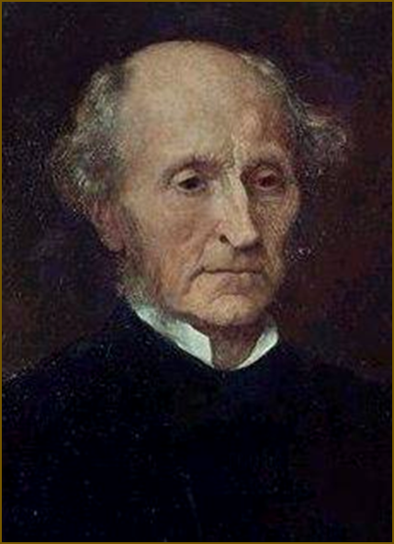
John Stuart Mill (1806-1873)
Wrote works on logic and metaphysics, history and literature, economics and political theory
Learned Greek at age 3; by 12 he was a competent logician; by 16 he was a trained economist
A Utilitarian and exemplified Liberalism
  On Liberty (1859)
    The sole purpose of government is “self-protection”
    Only interfere with individual liberty to prevent harm to others (“Mill On”)
    Maximize human development for a more equal society:
        Mill favored a more open administration
        Workers cooperatives
              Workers would have their own factories and choose the managers
        Redistribution system of wealth:
            Confiscation of excess profits
            Abolish the wage system
        Universal suffrage and emancipation for women (Chambers)
Click to Learn More

Slide 14
Utopian Socialists
Saint-Simon, Fourier, Robert Owen
French Revolution
Industrial Revolution
Socialism
New ideas of change and reform
Harsh conditions in mines and factories
Emphasized the well being of the collective community
Improving society acc. to principles of reason (Enlightenment)
Need for change and reform among workers
Goal could be achieved only by planned, state-directed social change (“Conservatism, Liberalism”)
Similarities:
All rejected the status given to women in bourgeois (equality)
Religion source of community feeling and ethics (Chambers)
People should promote the general happiness and welfare of everyone in society
Distrustful of politics and politicians
Control of social affairs should be in hands of "producers” (not kings, parliament) (“Socialism”)

Slide 15
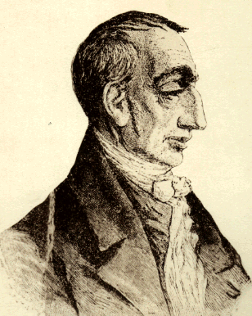
Saint-Simon (1760-1825)
Of ancient noble heritage
Fought alongside Lafayette and the American revolutionaries
  When he returned to France, he narrowly missed the guillotine
During the Directory, gained wealth—only to lose it all
Type of person (friend of financiers during Thermidorian Reaction)detested by Fourier
Kings, nobles and the clergy were useless (necessary in earlier historical era)
He idealized productivity, organization, efficiency, innovation and technological discovery (“Lecture 22”)
Saint-Simon’s Utopia:
Technocratic Socialism
Society led by technology and science
Science rather than religion to bind society
Control in hands of industriels, those who produce or make it possible to produce (bankers, engineers, intellectuals and scientists) (Baldwin)
No faith in free market as Adam Smith did

Slide 16
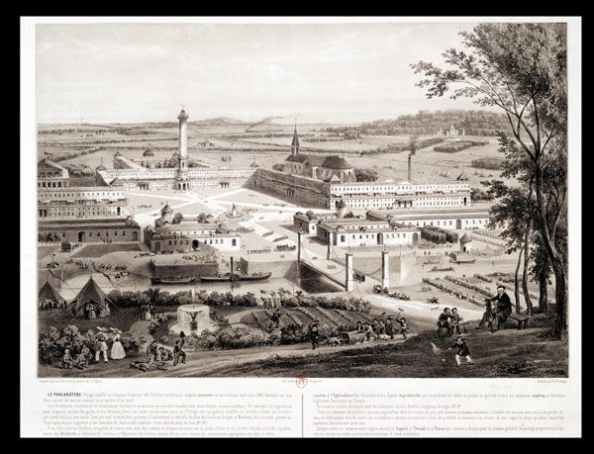
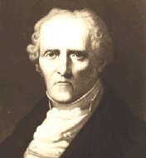
Charles Fourier (1772-1838)
Most of life worked in commerce, early years in Lyons
      Observed how the silk workers organize themselves
      Also observed effects of free market economy when re-established under the Directory
Did not support laissez faire liberalism or factory system; thought Industrialized society was a ‘passing phase’
Despised Adam Smith, Ricardo, and other political economists—too rational (“Lecture 21”)
  Wanted society bound by emotions
Fourier’s Utopia:
Psychological socialism
Phalansteries: communities (1,600 people) organized acc. to unchanging needs of human nature (Baldwin)
Based on complete suppression of individualism in favor of collectivism and cooperation (Blunden)
Attempt to be compatible with each member's "natural talents, tastes, and inclinations” (Fourier Social Destiny of Man)
Choose jobs you enjoyed (passions); those with special skills and responsibilities would be rewarded accordingly
Monogamy not important (“Lecture 21”)
In 1840s, 29 of these communities were est. in US—none lasted more than 5 or 6 yrs (Perry 521-2)
Click to learn more
French Phalanstery

Slide 17
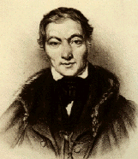
Robert Owen (1771-1851)
Textile factory owner in New Lanark, Scotland
Set up ideal working conditions:
  Shorter working hours
  Healthier and safer working conditions
  After-hours recreation
  Schools for children and adults
  Renovated housing
  End to child labor (“Lecture 22”)
  Made profits, productivity increased– New Lanark became a tourist attraction
Owen’s Utopia:
Industrial Socialism
Harmonious group living
Felt environment shaped character
  Public education and factory reform would make better citizens of the poor (Baldwin)
“Owen came to believe that the entire social and economic order must be replaced by a new system based on harmonious group living rather than on competition” (Perry 495)
1825, Community in New Harmony, Indiana failed (workers lacked motivation)
Click to learn more

Slide 18
Quote Identification QUIZ
Identify the theology that is best described by the quote
“Create all the happiness you are able to create; remove all the misery you are able to remove”
  Romanticism –Wordsworth
  Utilitarianism—Bentham
  Liberalism–Locke
  “Every man, as long as he does not violate the laws of justice, is left perfectly free to pursue his own interest his own way, and to bring both his industry and capital into competition with those of any other man, or order of men”
    Conservatism – de Maistre
    Economic Liberalism –Smith
    Charles Fourier’s “Utopia”
“Society is indeed a contract. It is a partnership in all science; a partnership in all art; a partnership in every virtue, and in all perfection. As the ends of such a partnership cannot be obtained in many generations, it becomes a partnership not only between those who are living, but between those who are living, those who are dead, and those who are to be born”
  Conservatism– Burke
  Utilitarianism—Mill
  Political Liberalism —Locke
  Which utopian socialist envisioned a society governed by science and technology with control in the hands of industriels?
    Charles Fourier
    Robert Owen
    Saint-Simon

Slide 19
Correct! You know your stuff!
Back to Quiz or I’m Done!

Slide 20
Oops! Incorrect
Try Again or I’m Done

Slide 21
Fun Links
Age of Ideologies: http://www.historyguide.org/intellect/lecture23a.html
Utilitarianism Resources: http://www.utilitarianism.net/
Stanford’s Encyclopedia of Philosophy: Liberalism http://plato.stanford.edu/entries/liberalism/
UCL Bentham Project: http://library.thinkquest.org/3376/Genktk6.htm?tqskip1=1&tqtime=0329
Stanford’s Encyclopedia of Philosophy: John Stuart Mill: http://plato.stanford.edu/entries/mill/
Robert Owen Museum: http://robert-owen-museum.org.uk/
Also check out the links all throughout the PPT!

